Slide 1
REINVENTION PARTNER
Digital Core
Technology Strategy and Transformation (TS&T)
20th May 2026
v.1 – for discussion with Digital Core ExCo

Slide 2
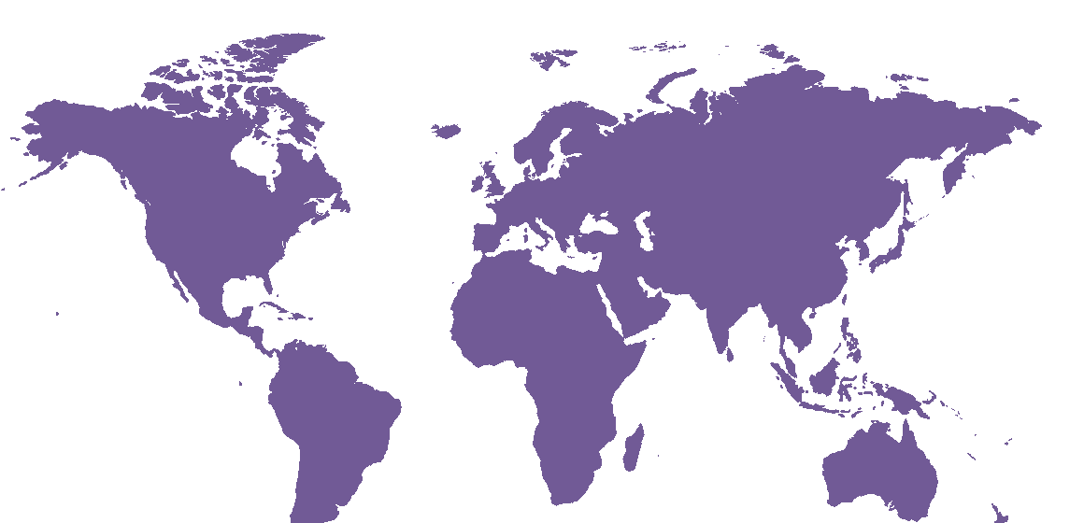
TS&T Activation – Fueling Digital Core Growth
Now is the moment to unlock TS&T’s full potential - expanding our surface area across Digital Core, converting advisory into scaled delivery, and exploiting catalysts for growth
Strong activation progress since March 1st
Mission and Purpose: Established clarity of purpose in the market and within Digital Core RP
Client Questions/Our Offerings: Defined TS&T blueprint aligned to key client buyer questions and challenges
Team: Unified ~7k global practitioners, appointed Market & Domain leadership. MU activation ongoing
RE Interlock: Fast start to RE interlock and engagement as basis for TS&T transformation execution
Our time together today:
CIO agenda 2026
TS&T sub-offerings – what, why and the imperative that all Reinventors own these in the market
TS&T x Digital Core – key intersections that will accelerate growth
Iconic client credentials
Stimulus for round table session at 11:30am ET

Slide 3
Digital Core Strategic Priorities
AI enablement, legacy transformation and emerging imperatives like resilience are converging in a capital-constrained environment - creating the most complex CIO agenda in a generation
AI-Enabled Enterprise
Digital Resiliency
01
AI-Enabled Enterprise is our primary mission as Reinventors…..
How do we move from pilots to enterprise-grade AI that's embedded in our operations?
What does our AI-ready data and infrastructure foundation need to look like, and how far are we from it?
How do we build an AI operating model - who owns it, how do we govern it, and how do we ready the workforce
After our outage, the board wants assurance it won't happen again - what does a resilient architecture actually look like for us?
How do we balance our cybersecurity investments with operational resilience?
How do we build a technology estate that's compliant by design rather than by exception?
02
… however Digital Core backlog is substantial – data readiness, reducing legacy, delivering the AI enabling architecture
Modernization
Capital Allocation
What's the modernization sequence that balances risk, cost, and speed?
How do we restart our stalled ERP transformation in a way that actually delivers?
How do we modernize our core without disrupting the business?
The board wants a 15% reduction - where do we cut without breaking the business?
How do we shift our IT spend ratio from 75/25 run-to-change toward something that actually funds growth?
Which productivity levers in our technology estate give us the fastest, most defensible savings?
03
In a macro environment (economic, geo-political, policy) that remains challenging with capital constraints
Speed to Market
Business Value Streams
Our product release cycle is 9 months while digital-native competitors ship weekly - what's holding us back and how do we close that gap?
We want to stand up a new digital business line in 6 months - what technology decisions do we need to make now to make that possible?
We fund technology through an annual planning cycle, but the business says we're too slow to respond - how do we shift to value-stream-based funding?
How do we connect our technology investments directly to business outcomes so the CFO can see what each dollar is producing?
04
CIO agenda moving at exponential pace. Clients need adaptive transformation partners that are value led

Slide 4
TS&T Sub-Offerings
Our revised TS&T offerings build on strong capabilities, with deliberate interventions to establish new sub-offerings and augment existing in response to rapidly evolving 2026 client demands
Industry Technology Strategy & Architecture
Digital Foundations
Strategic Technology Effectiveness
Technology Transformation Delivery
Lead at the intersection of business and technology to drive maximum client value through exploitation of AI, technology and data - serving as the primary architect of client's industry relevant technology estate
Advisory and functional architecture services across Digital Core pillars (AI/agentic, data, cloud/infra, enterprise SaaS/platforms) to deliver a modern and resilient digital core that enables enterprise AI adoption
Design and implement market leading practices in technology operating models, AI/tech value and economics and AI enabled SDLC to maximize business value from technology investments
Deliver complex, large-scale tech reinvention/transformation programs underpinned by robust transformation offices to track, manage and govern value outcomes of material enterprise reinvention commitments
Business Technology Strategy
Functional and Domain Driven Architecture
Technology & AI Cost Optimization, Full Stack FinOps and Value Realization
Transformation Delivery
Technology Visioning / Future Tech & Innovation
Cloud, Infrastructure and Ecosystem Advisory
AI Powered SDLC Strategy and Activation
Transformation Office
Enterprise & Technology AI and Data Strategy
AI/Agentic & Data Platform Strategy and Architecture
Technology Operating Model Design and Activation
Industry Enterprise Architecture (EA)
Technology Modernization Assessment, Architecture and Roadmap
Technology M&A Programs / Optimization
Technology Resilience Assessment, Architecture and Roadmap

Slide 5
TS&T <> Digital Core Intersections Critical to Growth
Intersections between TS&T sub-offerings and broader Digital Core are basis for growth
Example Digital Core catalysts:
Industry Enterprise Architecture serves as a critical control point for broader TS&T and Digital Core services
Cloud & Infra advisory partnership with IIS to drive infra and AI ops transformation and expand market leading position
Technology Modernization & Resilience partnering with S&PE to address material enterprise backlog and client challenges
AI for SDLC collaboration with S&PE to drive agentic SW Eng enablement, operating model and adoption
Transformation Delivery across DC to drive complex enterprise reinvention programs
TS&T Sub-Offerings |  |  | AI & Data | S&PE | IIS | MRS
Industry Technology Strategy & Architecture | Business Technology Strategy
 | Technology Visioning / Future Tech & Innovation
 | Enterprise & Technology AI and Data Strategy
 | Industry Enterprise Architecture (EA)
Digital Foundations | Functional and Domain Driven Architecture
 | Cloud, Infrastructure and Ecosystem Adv
 | AI/Agentic & Data Platform Strategy and Arch
 | Tech Modernization Assmt, Arch and Roadmap
 | Tech Resilience Assmt, Arch and Roadmap
Strategic Technology Effectiveness | Tech/AI Cost Opt, Full Stack FinOps and VR
 | AI Powered SDLC Strategy and Activation
 | Technology Operating Model Design and Activation
 | Technology M&A Programs / Optimization
Tech Tfn Delivery | Transformation Delivery
 | Transformation Office
Key: Example TS&T <> DC catalyst areas
Very high intersection
High intersection

Slide 6


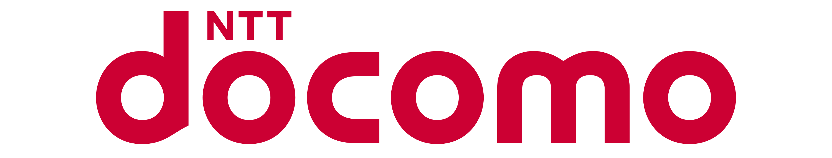



TS&T <> Digital Core – Scaling up from advisory to full reinvention
Iconic client case studies where the TS&T x Digital Core collaboration is driving growth
Advisory > Scaling > Full Reinvention
Advisory > Scaling > Full Reinvention
Advisory > Scaling > Full Reinvention
S&P
Driver: Business strategy and architecture disruption
Enterprise Data & Technology Strategy
CEO and SLT + TLT
$5-10m pa TS&T revenue
Emerging enterprise reinvention motion
Google ecosystem partnership opportunity
Boeing
Enterprise Tech and AI Strategy
5 Year Roadmap for $20B Tech spend
CFO/CIO Driven + BG CEOs
Boeing 2030 growth driver to double output of Planes and Services
Grow Defence business F-47 Win
Launch new commercial 7X7
PPL
Tech Driven Reinvention to Agentify Enterprise and Grow Data Centers
CEO / CTIO led Driver One PPL Strategy
5 Business value streams currently including AMS/IMS/SMS
IT 87% Run to 38% Run in 18 months, deploying agentic arch in 5 workflows currently
First 2 years, $1B spend total, largest TS&T revenue in Americas
Natwest
Driver: Business strategy 2030
Digital Spine EA key control point
CIO & CTO
$5-10m pa TS&T revenue
$75m+ annualised DC revenue (e.g. EDT program) and scaling pipeline (e.g. Core Banking modernization)
AWS ecosystem partnership
Docomo Global
Tech Driven Growth Strategy
$6B, 7-year growth play
Enterprise wallet infrastructure for the agentic internet and the tokenization of identity, money, and objects
Tech + Product Strategy, Innovation, GTM, FDE (Forward Deployed Engineers)
Corebridge/Equitable
Merger of 2x 10B Life and Annuity Ins
Implement AI Native Agentified NewCo Business and Tech - M&A Integration to the New
Agentify 80% of workflows – guarantee outcomes / client partners in reinvention campaign
Anchor "AI First Reinvention Partner"
$2.2B total, TS&T $500M

Slide 7
TS&T Dual Role – Advisory + Scaled Digital Core Pull Through
Maximising the dual role imperative for TS&T of both retained advisory and scaled Digital Core pull through
TS&T
Advisory
Maximising the dual role imperative for TS&T of both retained advisory and scaled Digital Core pull through:
Increase surface area of TS&T advisory teams in alignment with CGs and CALs
Establish blended teams TS&T x broader Digital Core around key intersections e.g. TS&T Digital Foundations <> Intelligent Infrastructure Services
Proactive Go to Market posture with TS&T acting as Reinvention architect – contributing to MRS deal shaping
Collaboration between TS&T and Digital Core sales and solutioning teams is critical
For discussion in round table:
MD metrics that incentivise craft plus pull through
Dedicated / ring-fenced TS&T capacity to drive proactive expansion of advisory into scaled Digital Core deal shapes e.g. Technology Driven Growth squad in NA
Strengthening dedicated TS&T sales and solutioning teams to continuously monitor opportunities for expansion
Digital Core Pull Through

Slide 8
Accelerating our TS&T Transformation with the RE
Our transformation partnering with the RE is structured around Work, Workbench and Workforce
Work | Workbench | Workforce
CG/CAL Interlock: DC collaboration with CG/CAL stakeholders to re-establish our role and secure mind share (for priority industries/clients) DC Client Targeting: Assessment of client TS&T<>DC penetration, reinvention propensity and opportunities for bi-directional pull through Offerings: TS&T <> DC offering alignment & collaborative offering development Sales Motions: End-to-end DC offering architecture throughout sales motion journeys Campaigns: Market/MU sales motion campaign Account Planning: Approach for coverage, representation and thought leadership at priority client accounts | Offerings: Industrialisation/agent-ification of offerings and augmentation for AI-era Capabilities: Joint development re-useable sales & delivery assets Content Harvest: Targeted client assetization of content, assets and thought leadership Tooling: Establish suite of persona aligned AI tooling to accelerate, increase quality and effectiveness of practitioners Delivery Methods: Re-design priority offering delivery methods to exploit AI capabilities throughout Ecosystem: Re-baseline strategic ecosystem partnerships across TS&T and downstream DC delivery | Recruitment: Priority recruitment to bolster/fill gaps; people transfers and/or rotations within DC Job Families: Redefine job families to represent future workforce requirements Workforce: Determine future looking fit-for-purpose resource pyramids and action plan for controlled evolution Skills: Define next gen skills for practitioners Training: Targeted training and/or joint initiatives to address talent and skill development

